Slide 1
Population and Economic Trends Douglas County, Castle Rock, and Colorado
Rob Kemp
State Demography Office
Colorado Department of Local Affairs
2015
www.colorado.gov/demography

Slide 2
State Demography Office
State agency
Responsible for population data needed by state agencies
Department of Local Affairs
Prepare data and information in ways that account for local perspectives, needs
Public information
Make data and information readily available to the public, including citizens, businesses and non-profit agencies
Outreach
Work with local governments and others to understand what the numbers are saying

Slide 3
Current Population

Slide 4
Big Picture Population Change
US 2015 – 321 million, + 2.5 million or 0.8%
Colorado 2015- 5,456,574
2nd fastest growth at 1.9%
8th largest absolute change adding 100,986
Douglas 2014: 314,592 (+2.3%)
Castle Rock 2014 – 54,364 (+2.8%)
Growth Varies Across the State
Notes:
Castle Rock is largest Incorporated Area in Douglas, Unincorp is largest (Highlands Ranch, Roxborough, etc)

Slide 5
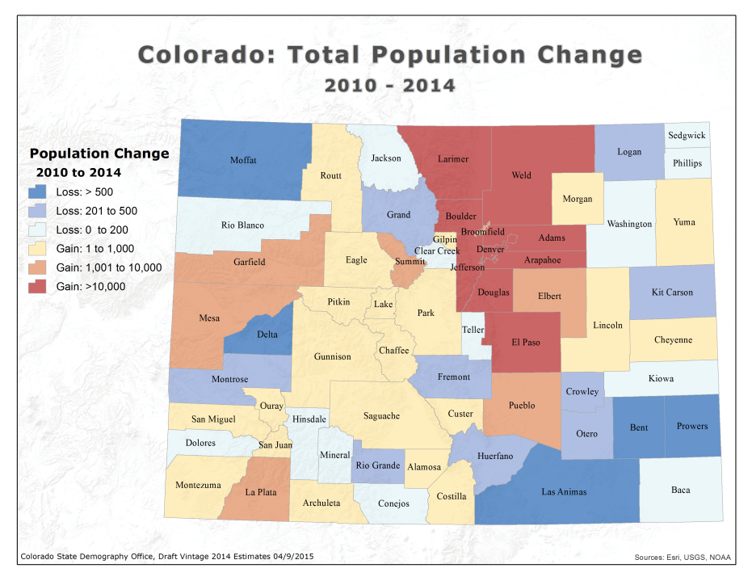
Notes:
29 negative growth 10-13 – 27 negative growth 10-14
19 with negative pop change 13-14
12 negative natural increase 12-13
9 negative natural increase 13-14
23 negative net migration 13-14
30 negative net migration 12-13

Slide 6
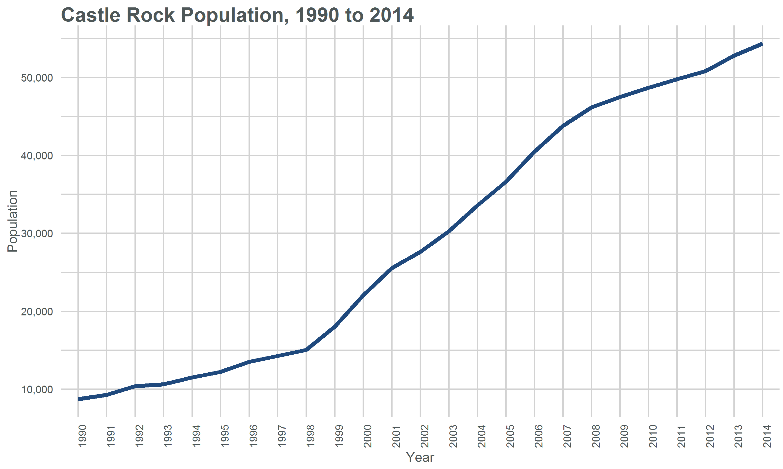

Slide 7
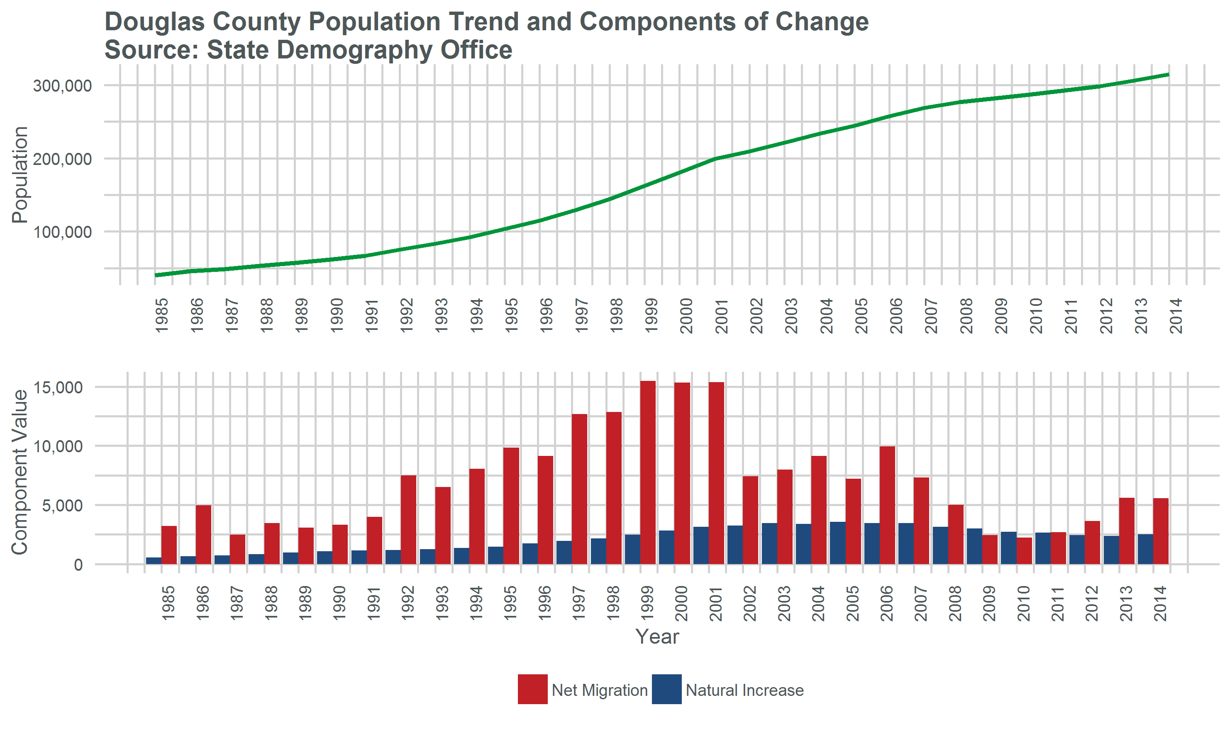

Slide 8
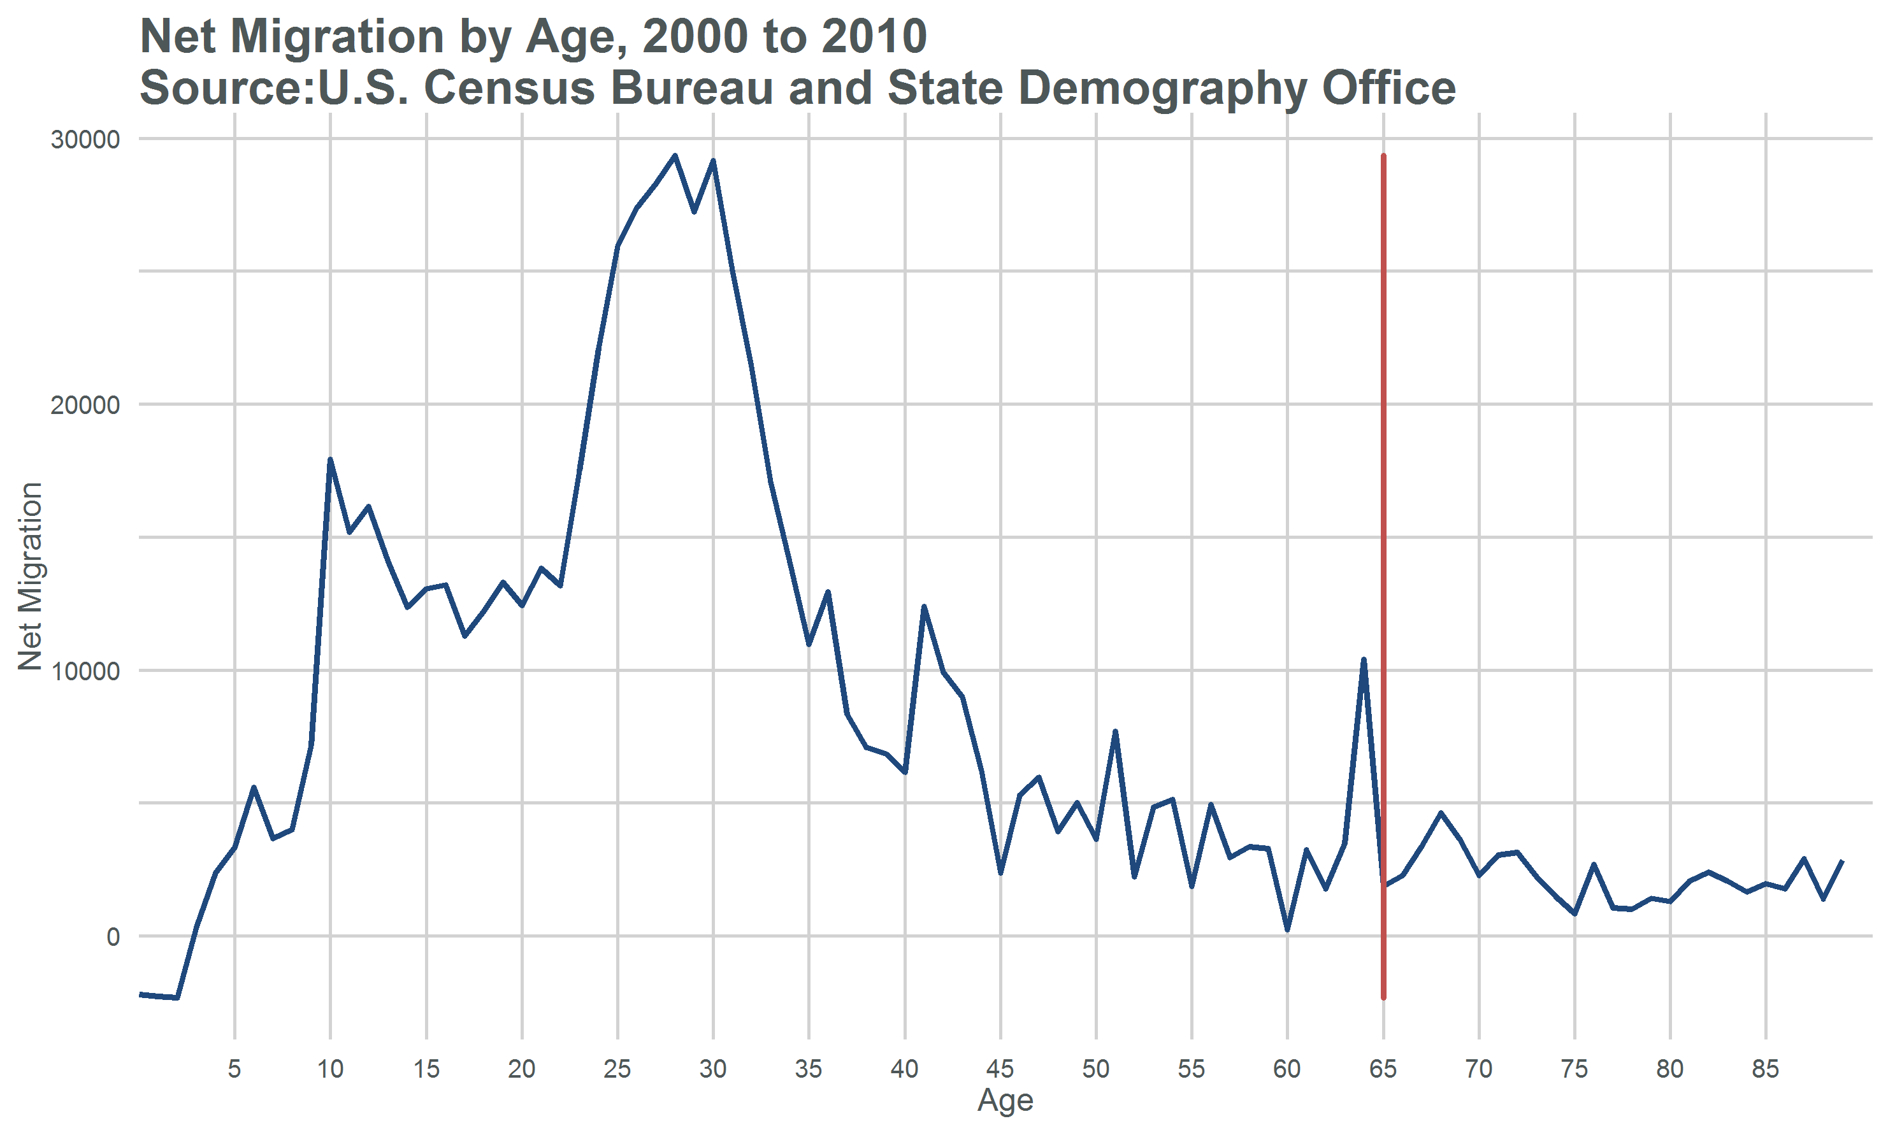
Notes:
Who are the movers?

Slide 9
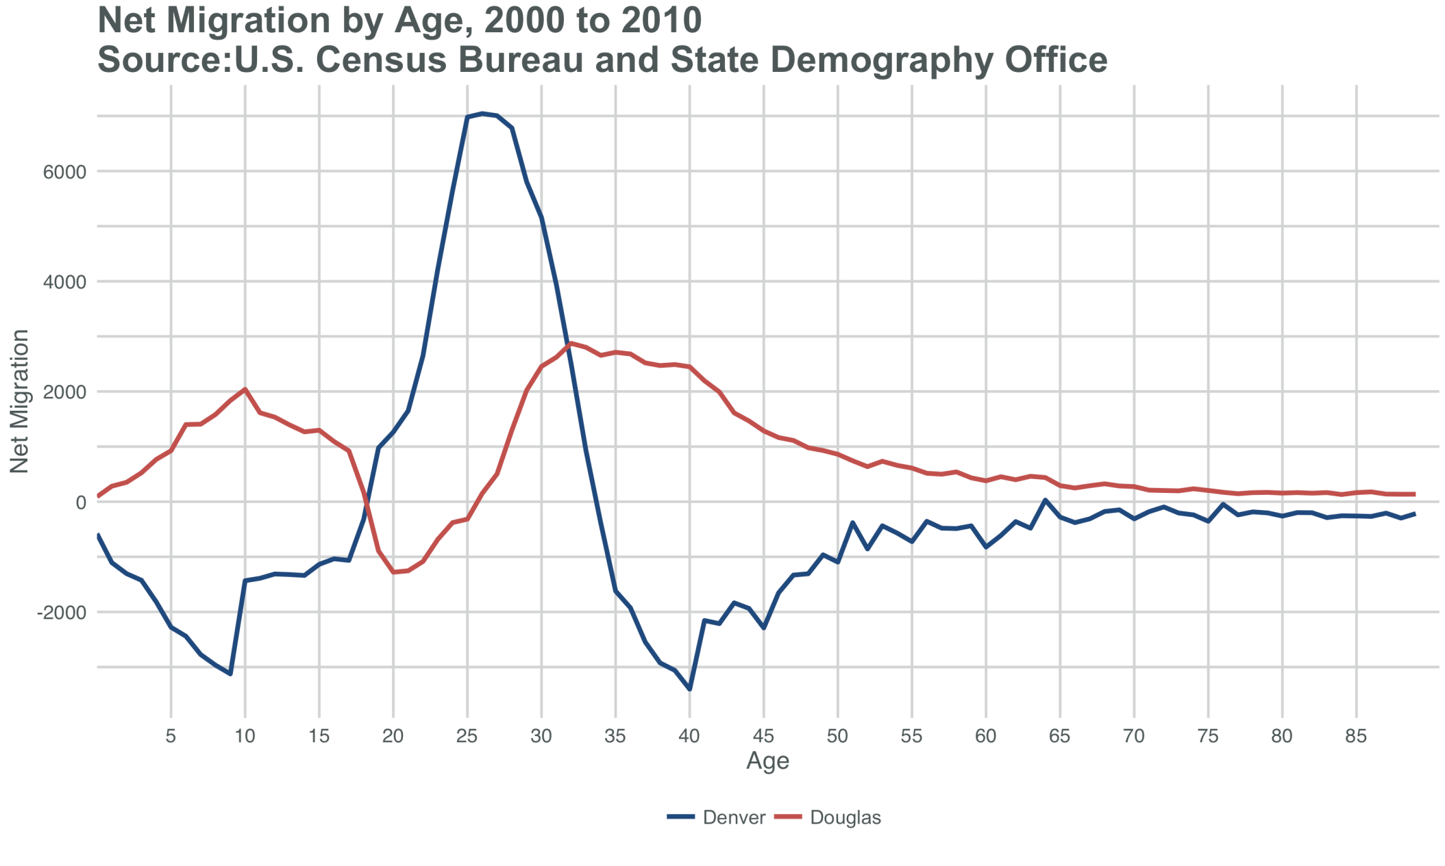

Slide 11
Jobs

Slide 12
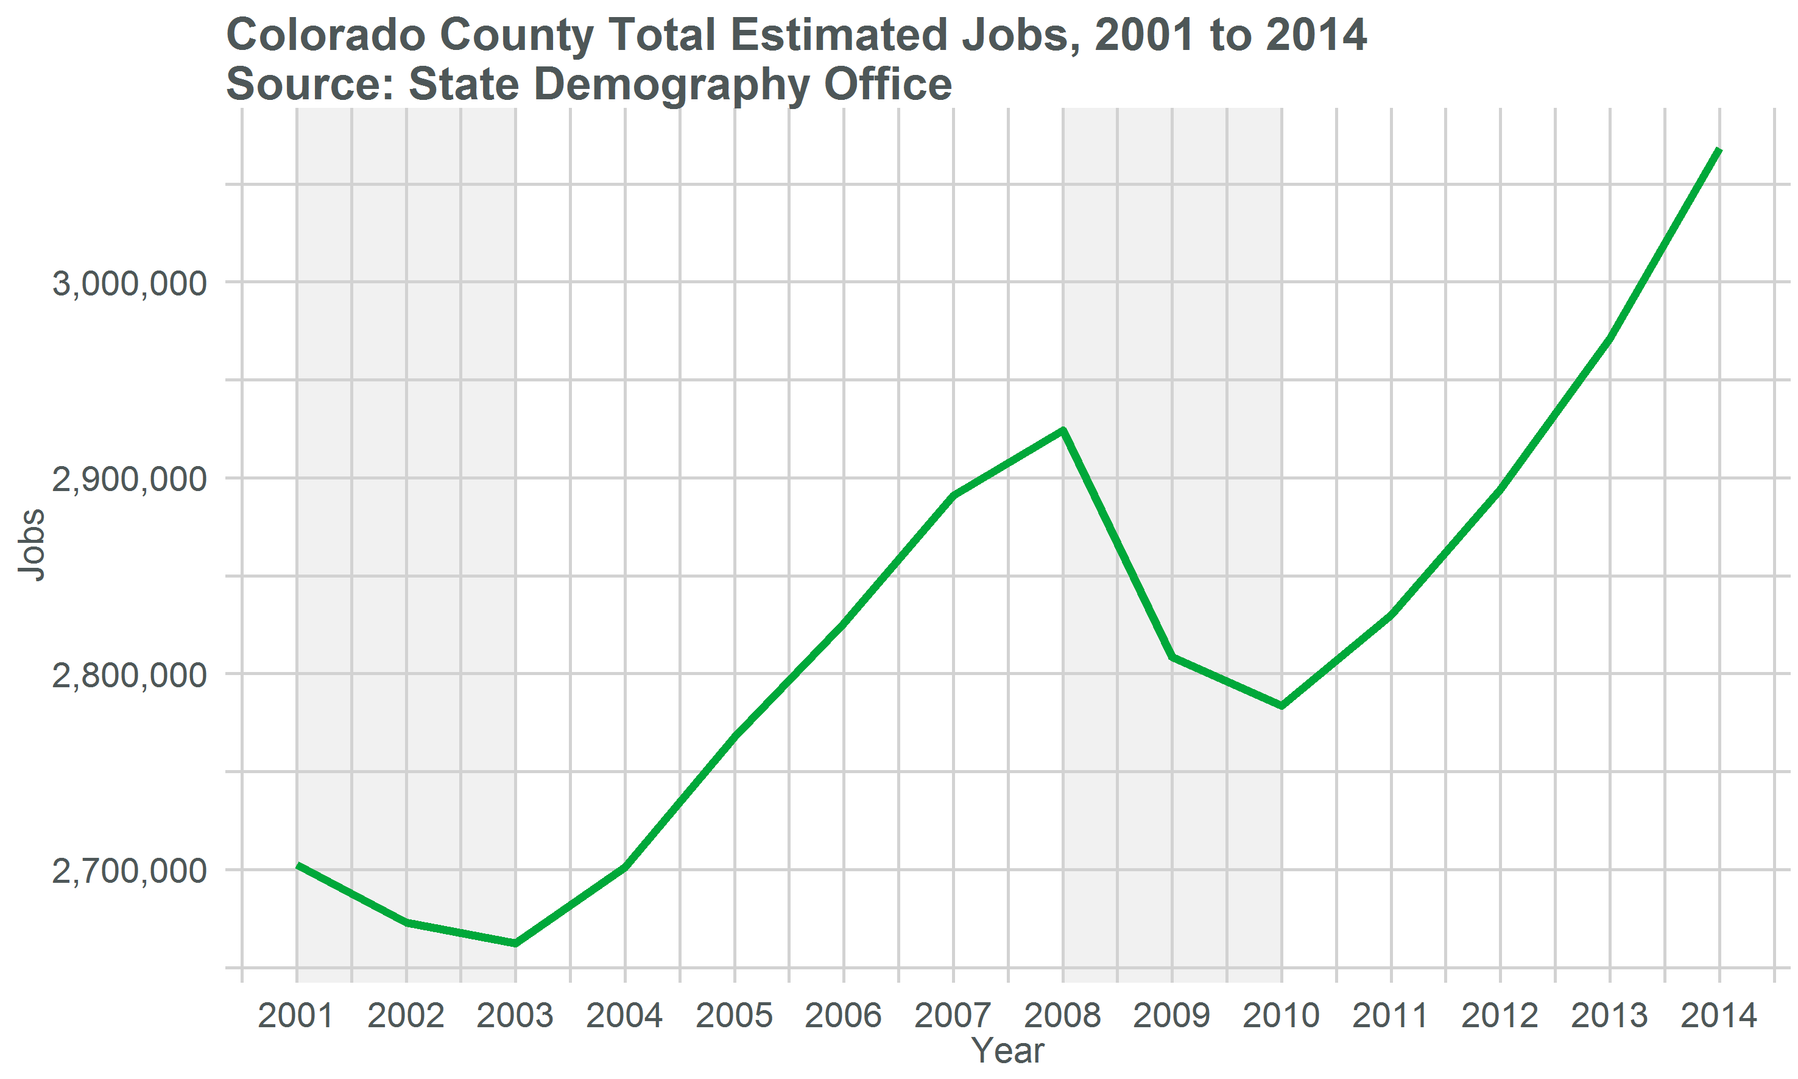
Make Font Bigger

Slide 13
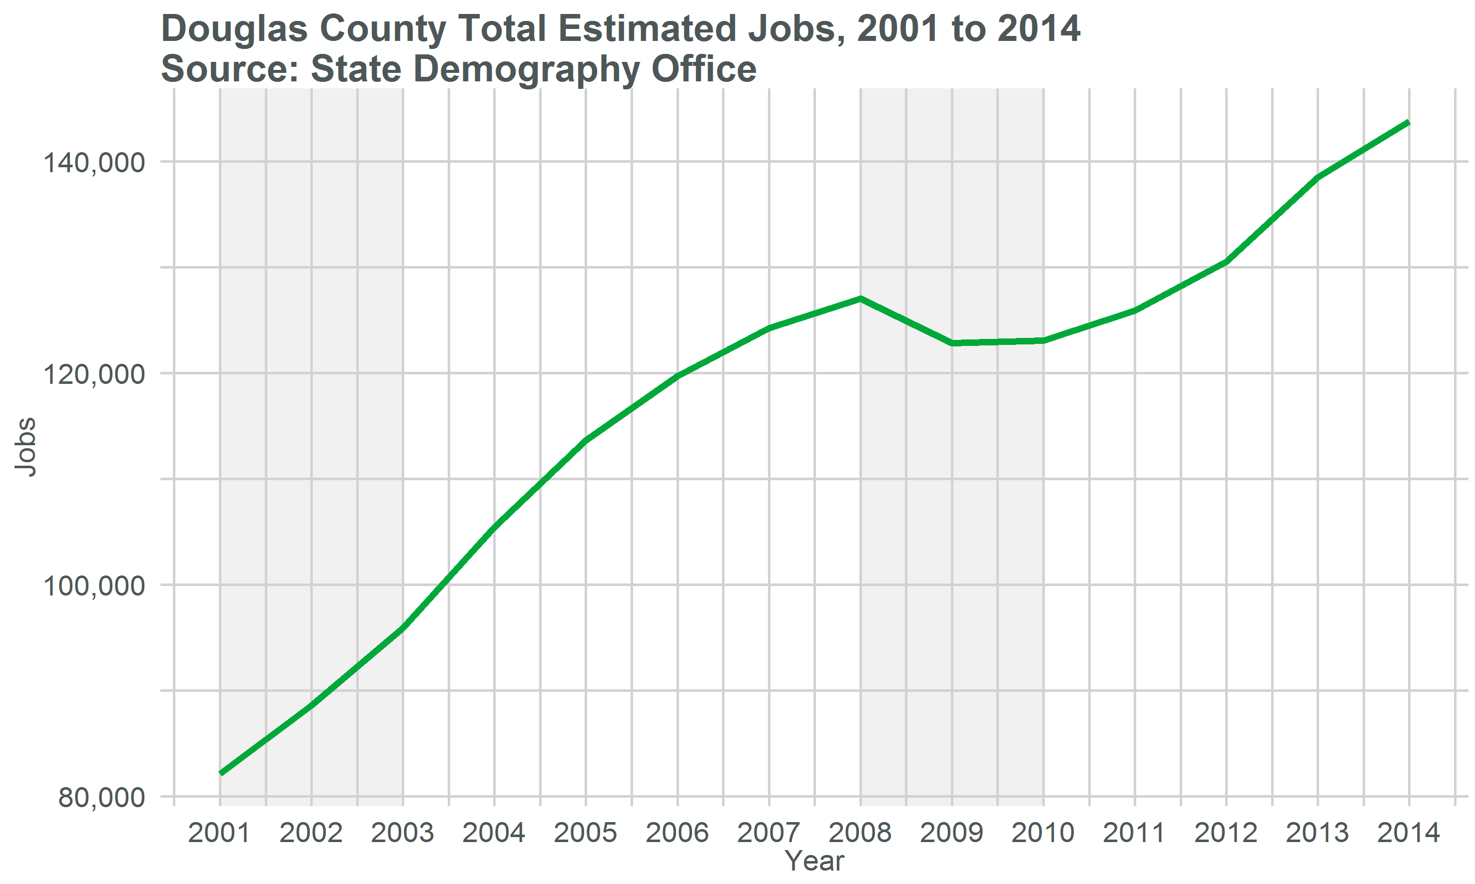

Slide 14



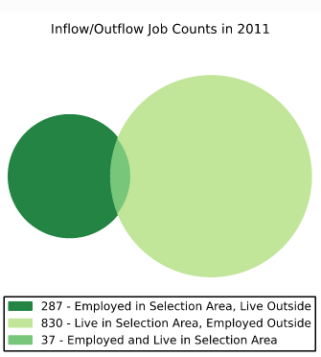
Commuting - 2013
Douglas
Castle Rock
Highlands Ranch CDP
Employed in Place
Labor Force in Place
Live and Employed in Place

Slide 15
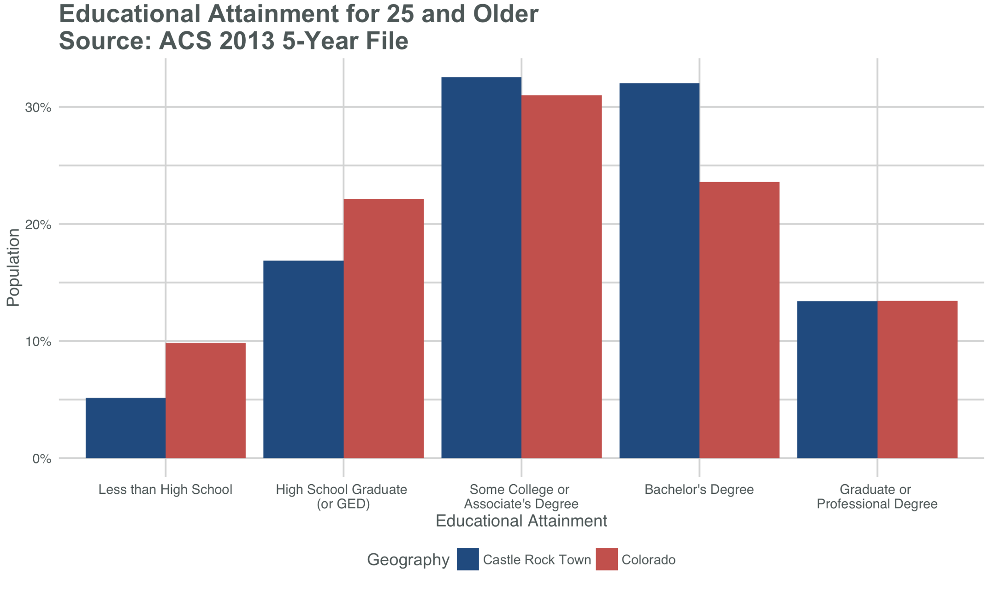

Slide 16
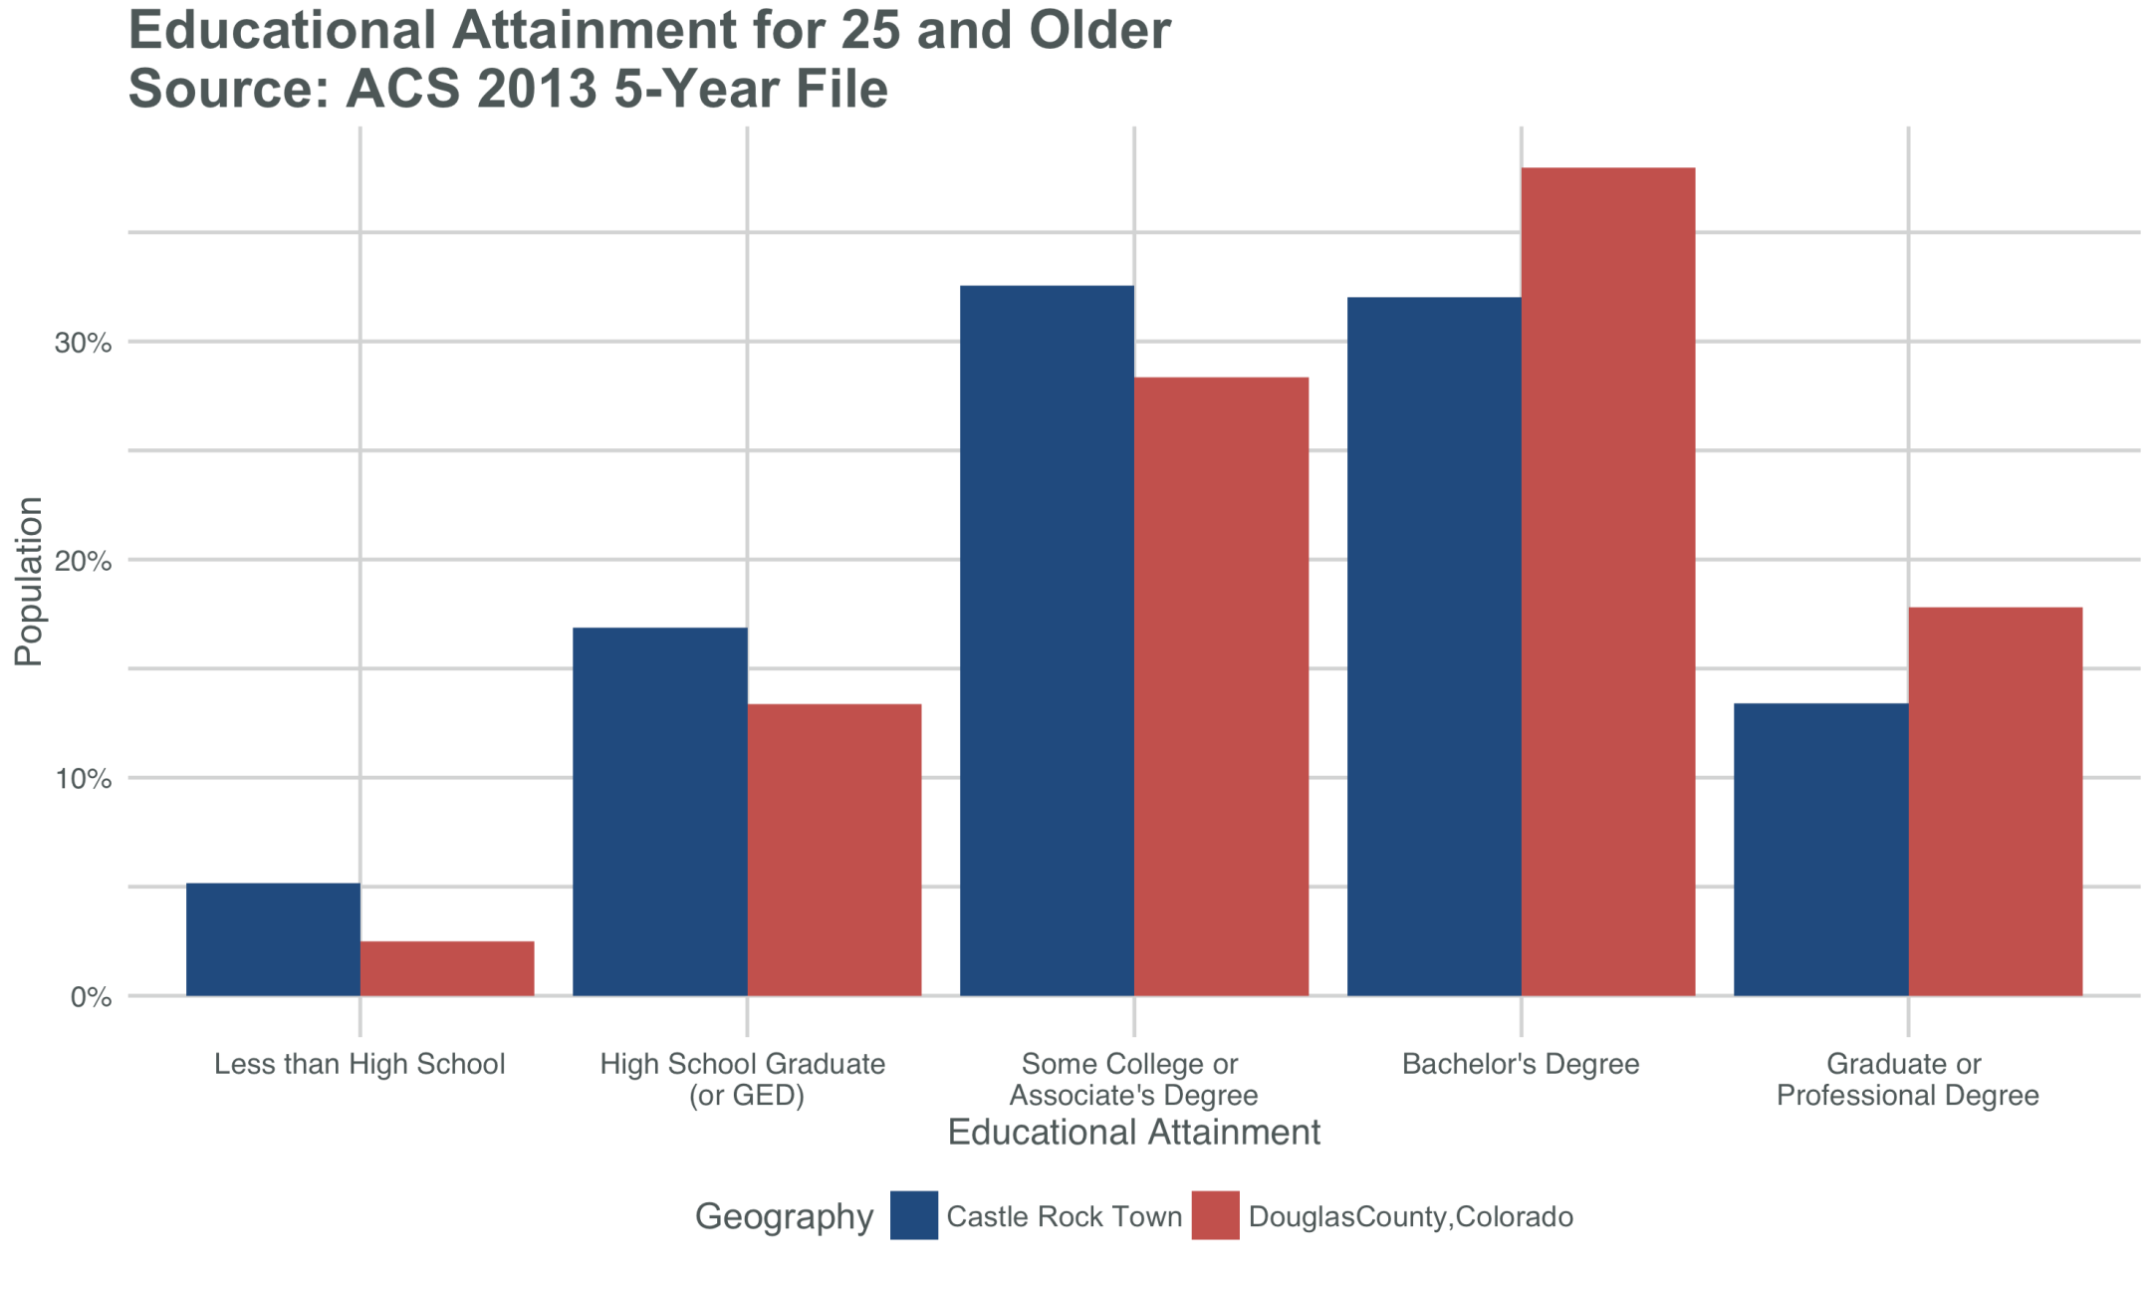

Slide 17
Projections and Aging

Slide 18
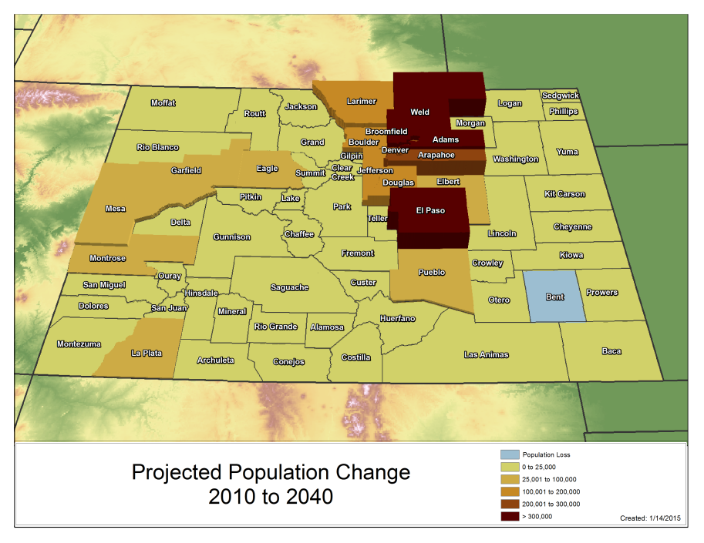
Colorado – 7,925,230
Douglas - 482,079
Notes:
Change from 2010-2040
State – 2.7 mill
Front Range – 2.1 mil
Denver Metro – 1.2
NFR - 500K
SFR - 400K
WS - 400K
CM - 76K
SLV - 20K
EP - 82K

Slide 19
Why Are We Getting Old Fast?
Currently very few people over the age 65.
4th lowest share of all states in US (10%)
Baby Boomers
Born 1946 – 1964
1,340,000 Boomers in Colorado (26% of pop. in 2010)
By 2030, Colorado’s population 65+ will be 125% larger than it was in 2010 growing from 555,000 to 1,243,000. (just from aging)
Transition age distribution from “young” to more US average between 2010 and 2030.
Source: Census 2010 and State Demography Office

Slide 20
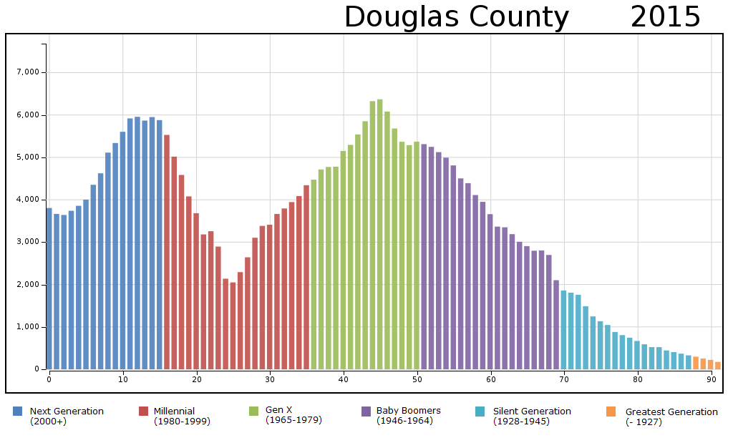

Slide 21
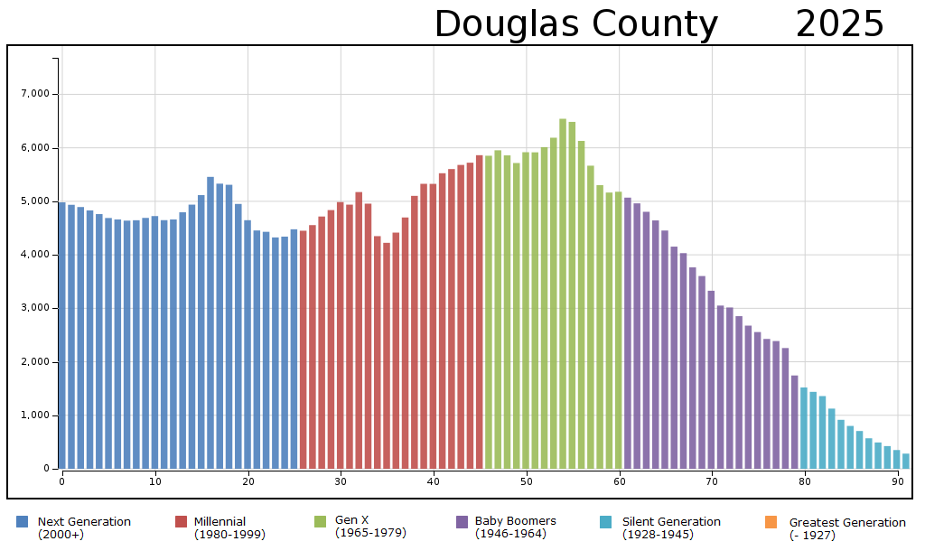

Slide 22
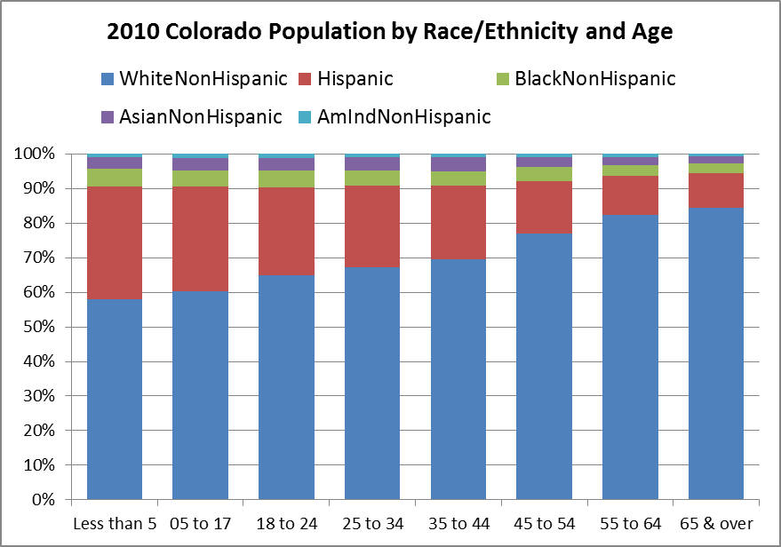
Census Bureau
Notes:
This makes it look like aging Hispanics may not be a big deal but between 2000 and 2010 Hispanic 65+ increased by 56% compared to the entire population which increased by 32% Forecast to increase by 97%

Slide 23
Household Income….its future is demographically challenged.
Age distributions – “End of “Demographic Dividend”
Occupational Mix – high and low service
More race/ethnicity diverse especially at young end but achievement gap is growing as well.
Household type and size – single and smaller.
Youth un and under employment - Long term permanent impacts on earnings.
State Demography Office
Notes:
Douglas MHI - $102,626, 1st by $20k to Elbert
Increases in Poverty for County without much currently

Slide 24
Long-Term Challenges - Colorado
Maintaining Economic and Amenity Advantages
Everyone competing for best and brightest.
Growth in high and low skill/wage service jobs – bifurcation
Disparate growth across state.
More racially/ethnically diverse.
Coping with opportunities and challenges of an aging population
Transitions in the Labor Force
Participation Rates, growth rates of labor force
Income – downward pressure on per household income….. And state revenues.
Notes:
Now lets look at

Slide 25
Thank you
State Demography Office
Department of Local Affairs
Rob Kemp
Robert.kemp@state.co.us
303-864-7755
www.colorado.gov/demography

Slide 26
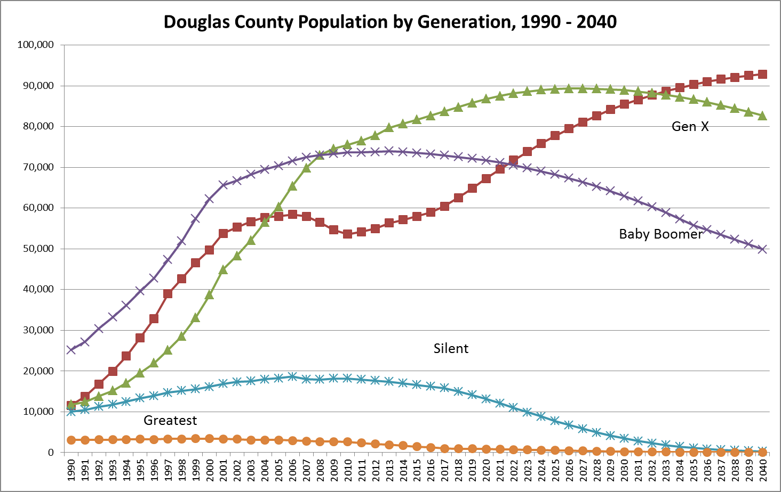
Millennial

Slide 27
Aging and Public Finance
Ratio of 65+ per 20-64 year olds in CO
Becoming more “normal”
End of the “demographic dividend”
Public Finance – change in revenue and expenditures.
Income tax – downward pressure
Sales tax – downward pressure
Property tax – downward pressure
Health services – increasing
Medicaid - increasing

Slide 28
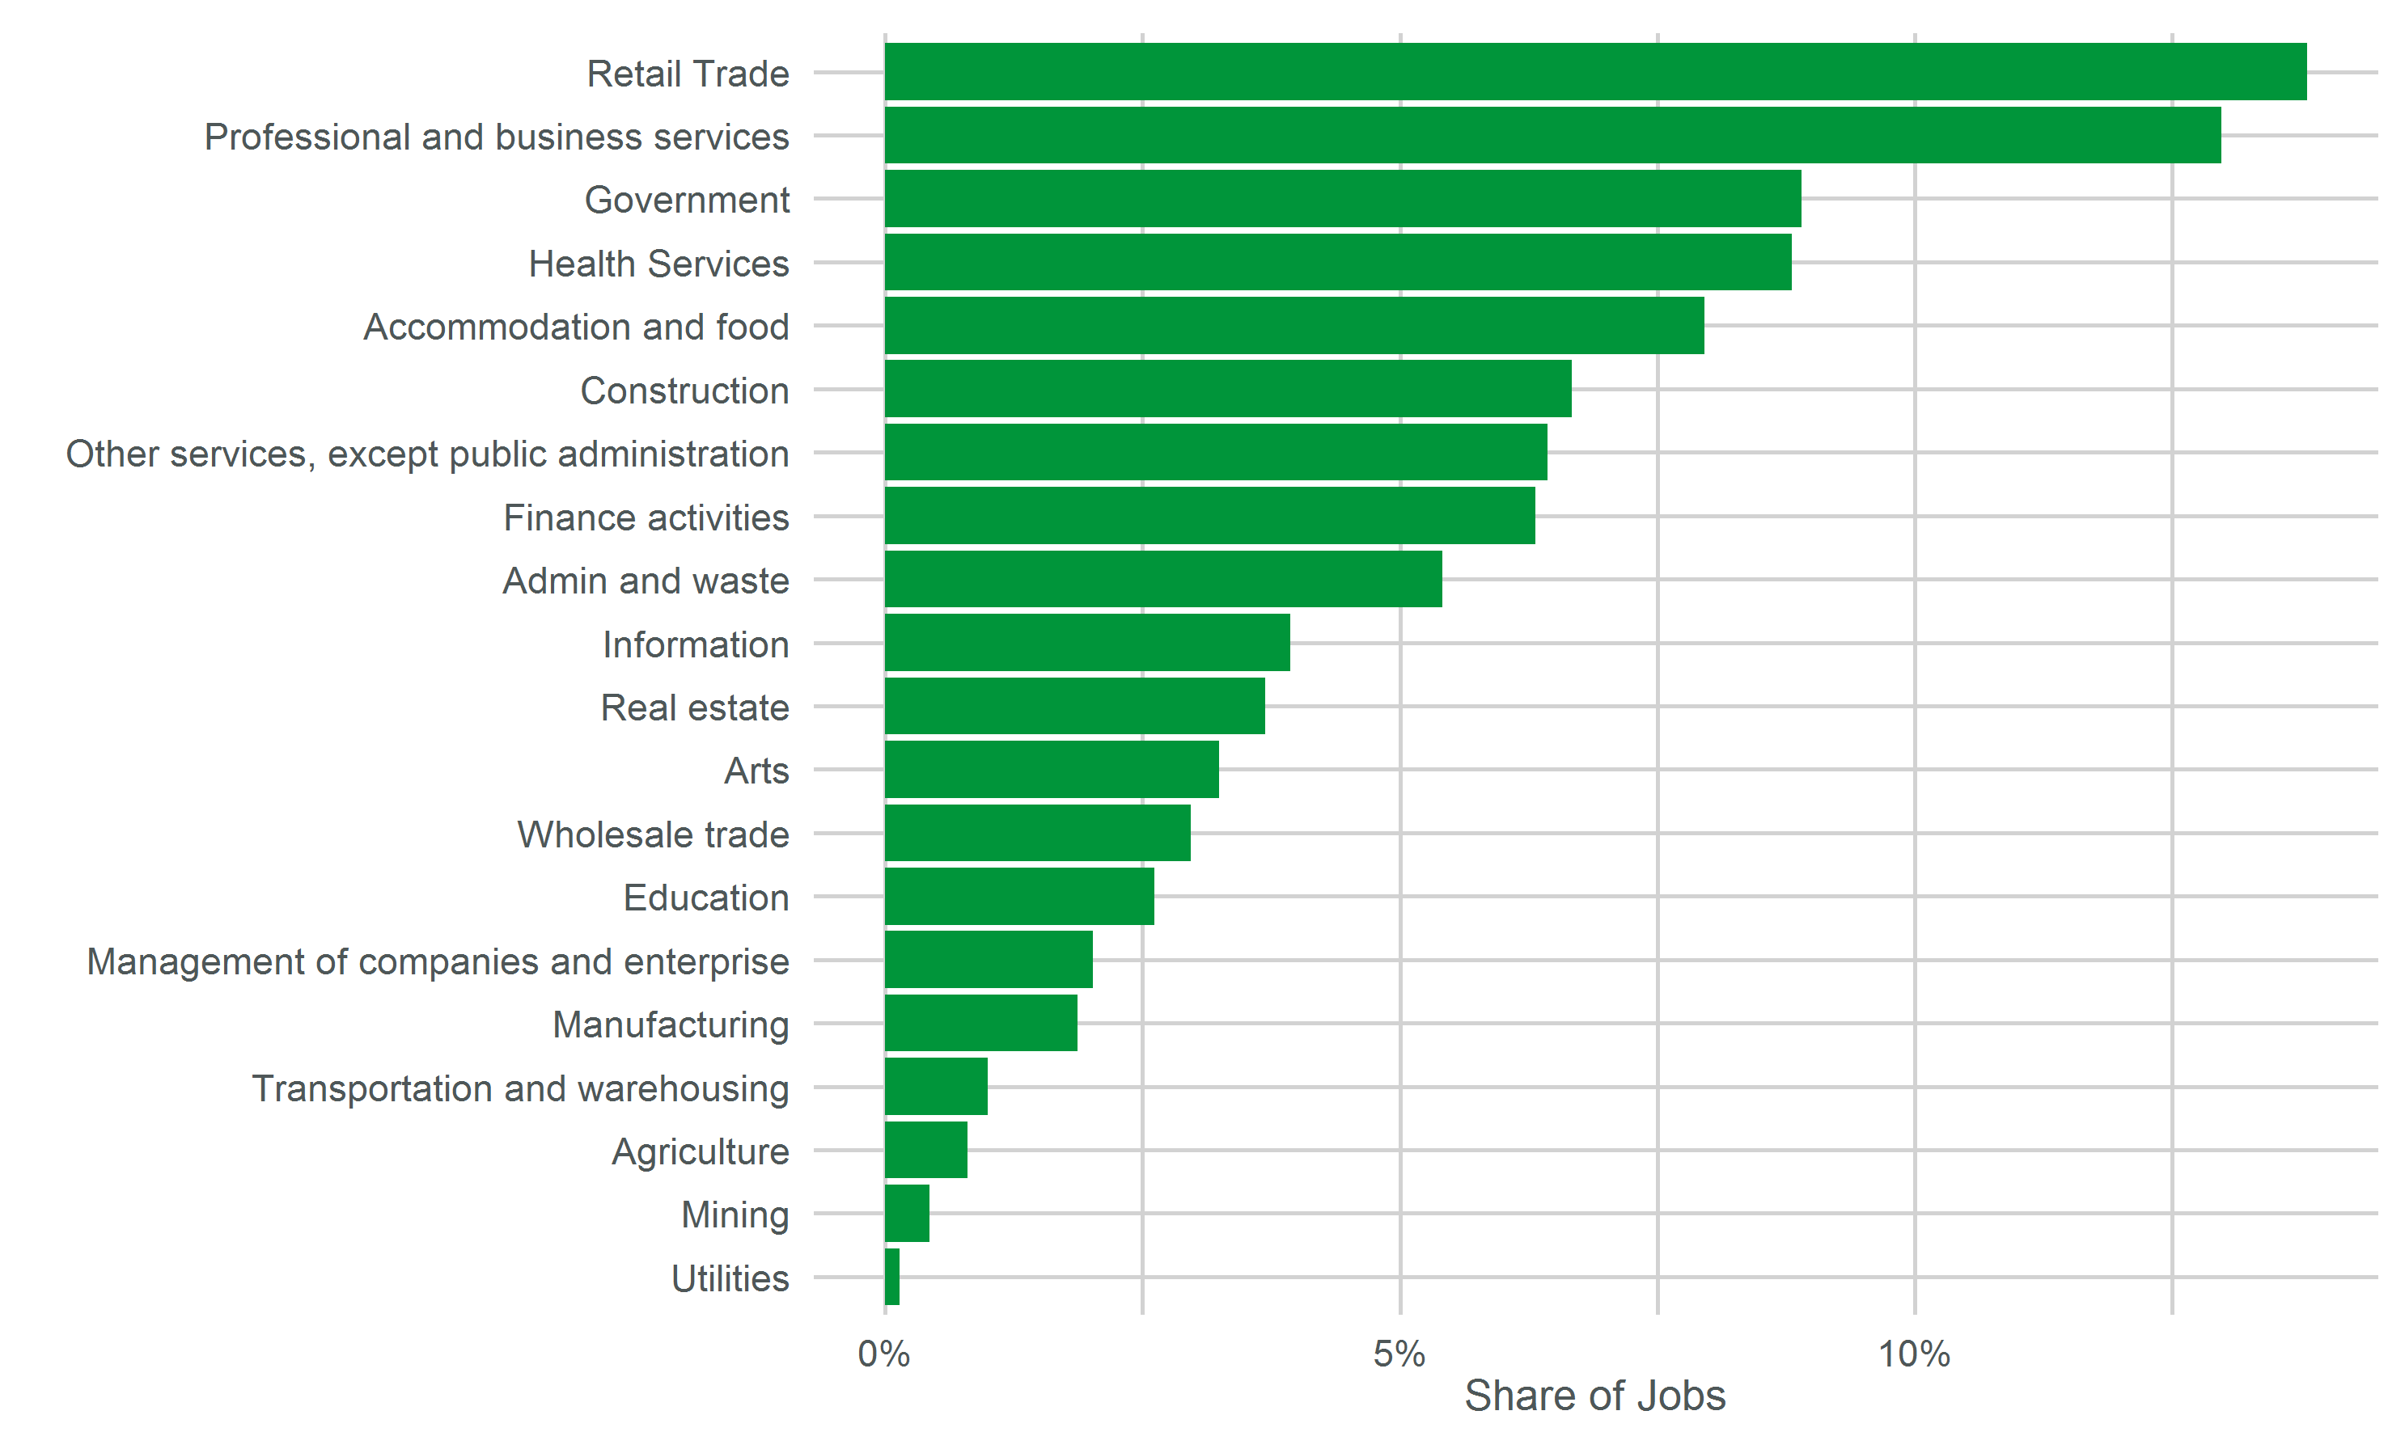
Douglas County Share of Employment by Industry in 2014
Source: State Demography Office

Slide 29
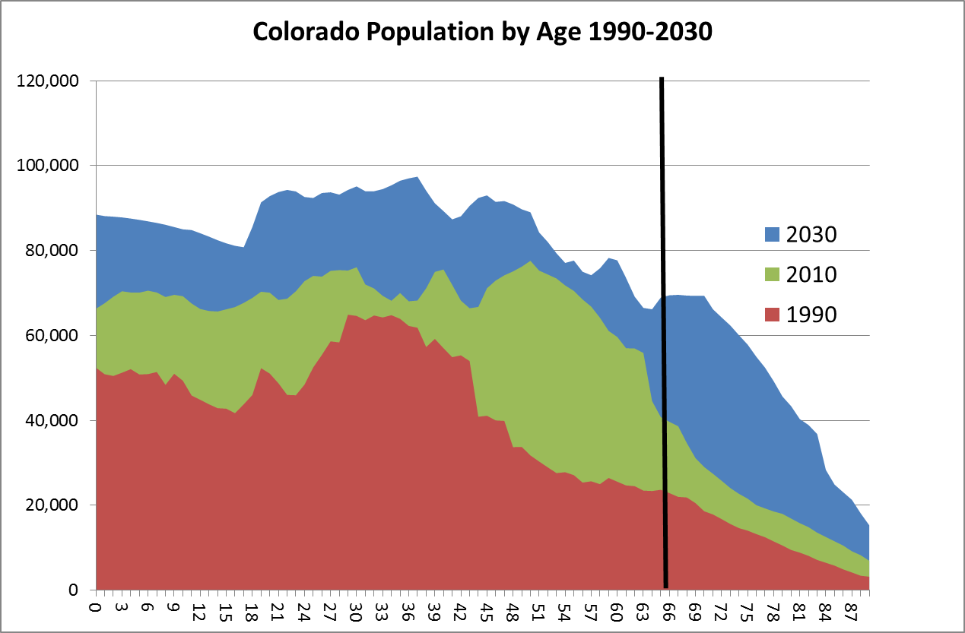

Slide 30
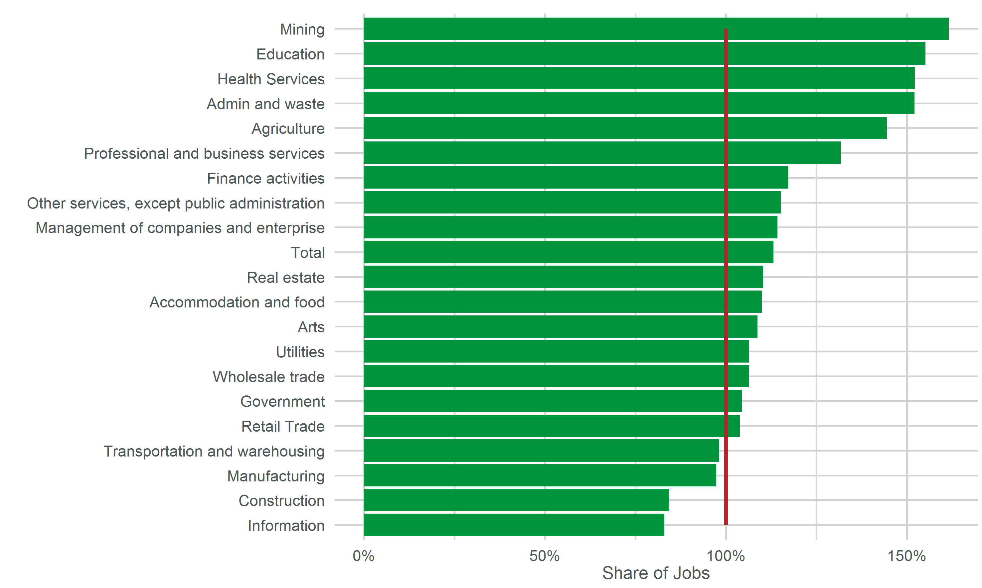
Douglas County Employment in 2014 as a Percent of 2008 Employment
Source: State Demography Office

Slide 31
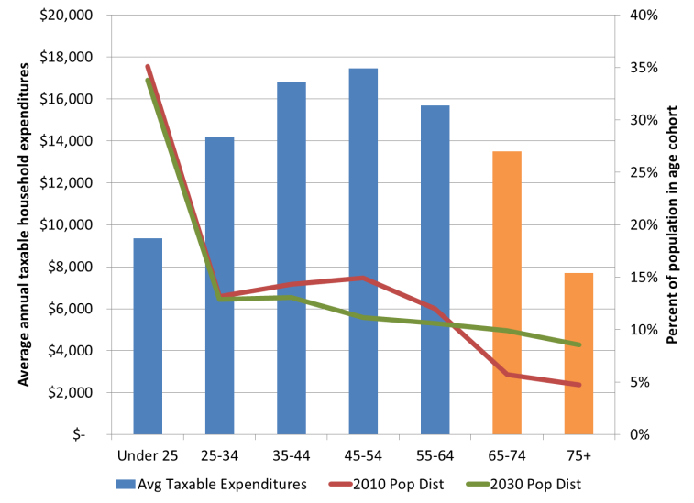

Average Taxable Expenditures and Colorado population in 2010, 2030
Source: Bureau of Labor Statistics Consumer Expenditure Survey (2009), State Demography Office
Notes:
Average taxable expenditures also change with age, with 65+ making on average few taxable expenditures.
This will impact per capita sales tax in Colorado. Below are examples of the potential impact using forecasts of households by age in Colorado.

Slide 32
2015 POVERTY GUIDELINES FOR THE 48 CONTIGUOUS STATES
AND THE DISTRICT OF COLUMBIA
Persons in family/household | Poverty guideline
1 | $11,770
2 | $15,930
3 | $20,090
4 | $24,250
5 | $28,410
6 | $32,570
7 | $36,730
8 | $40,890

Slide 33
Aging Issues
Numbers
Colorado has never had many older people
4th lowest in 65+ (2010 Census)
Migrate in people primarily 20-40
Economic Driver - wealthier …. depends
Spending of people 65+ supported approximately 137,000 jobs in 2010. (.25 jobs per person 65+)
Forecast to support 346,000 by 2030
Impact on occupational mix
Health Services both high and low end
Health Services – est. .1 job per person 65+ (55,000 in 2010 growing to 124,500 in 2030)

Slide 34
Forecasts - Trends
Growth in race/ethnic diversity – especially at the young end.
Growth in Young and Aging
Growth in both high and low end service
Labor Force Changes
Income Challenges
Transition Decade

Slide 35
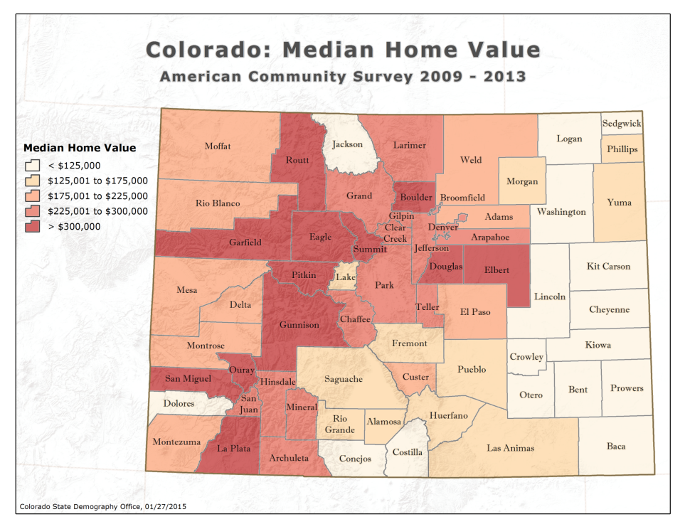

Slide 36
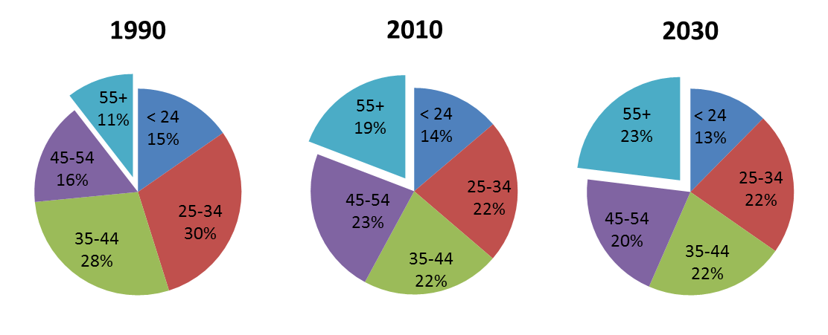
Share of labor force by age group
State Demography Office

Slide 37
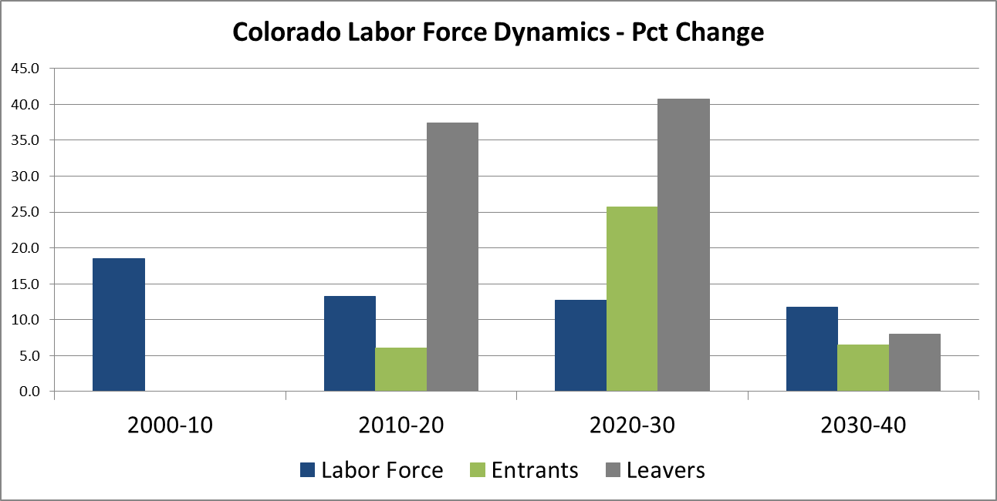
Growth in “leavers” will create more demand for workers
Source: State Demography Office

Slide 38
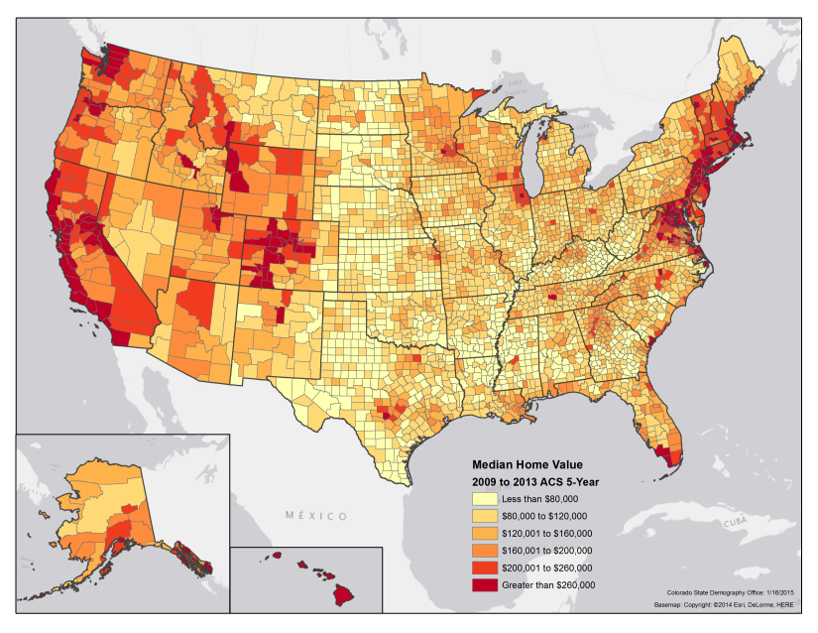
Median Home Value

Slide 39
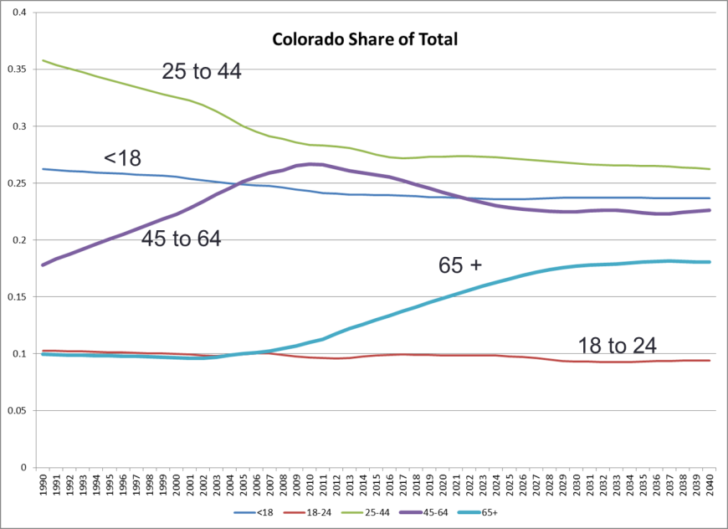
1990-2010
2010-2030
2030+
Source: State Demography Office
Notes:
We are currently nearing the middle of a very unique decade in the history of the age distribution of Colorado’s population.
This most significant event is the aging of the baby boomers – something most of the people in this room are uniquely familiar with due to the impacts their aging will have on the labor force, economic development, housing, transportation, health services and public finance just to name a few.
We can watch as between 1990 and 2010, the baby boomers aged out of the 25 to 44 year old age group, while the share of persons age 45 to 64 increased as a result over the same time period.
This current decade we see the share 45 to 64 drop as those same baby boomers age into the 65 and older age group and we see those dramatic increases in the blue line
Expect age distribution to remain relatively stable after 2030.

Slide 40
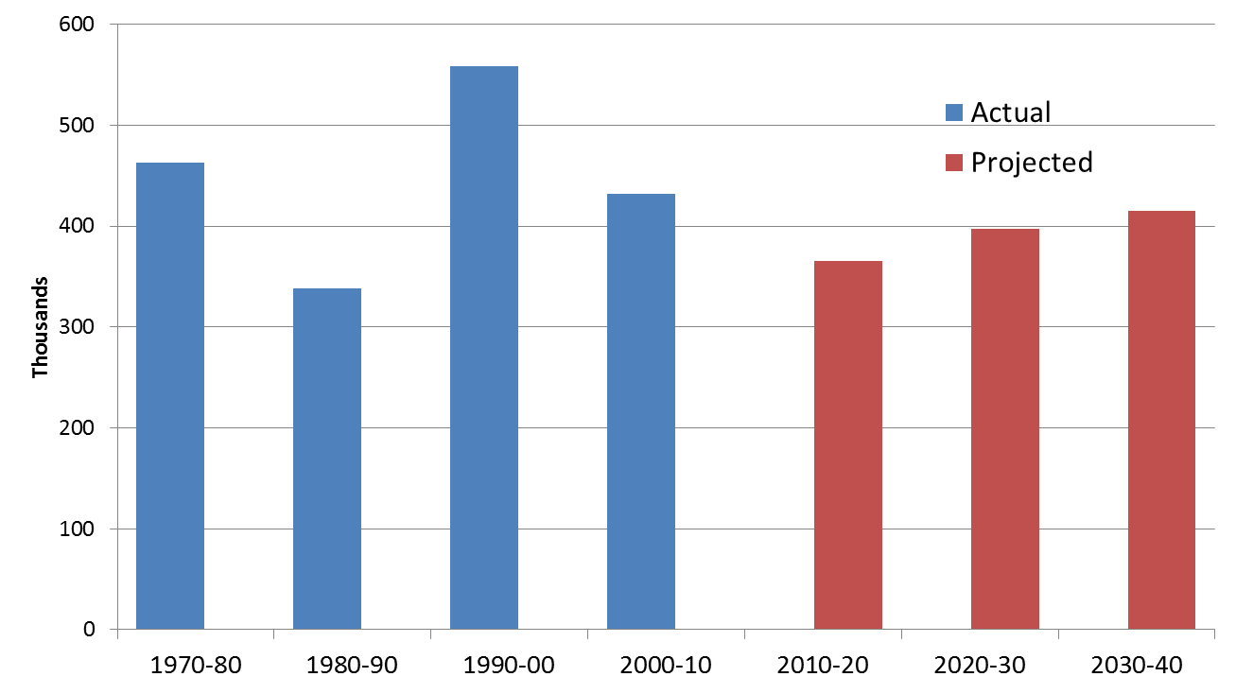
Colorado labor force change 1970-2040

Slide 41
Aging and Public Finance
Ratio of 65+ per 20-64 year olds in CO
Becoming more “normal”
End of the “demographic dividend”
Public Finance – change in revenue and expenditures.
Income tax – downward pressure
Sales tax – downward pressure
Property tax – downward pressure
Health services – increasing
Medicaid – increasing
Transition

Slide 42
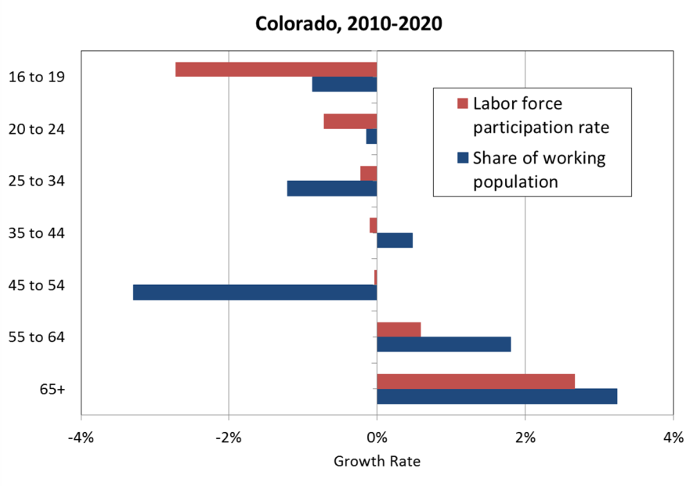

Slide 43
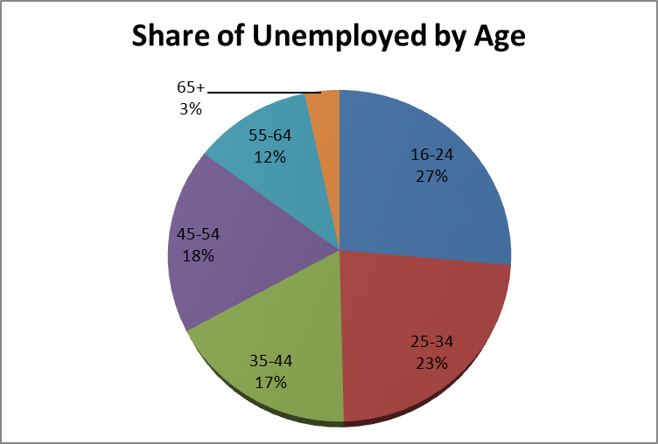
Labor Force 16-34 is 35% of the labor force yet 50% of the unemployed
Source: Bureau of Labor Statistics 2011 Annual Average
Notes:
Labor force16-34 years old – 35% of labor force yet 50% unemployed.

Slide 44
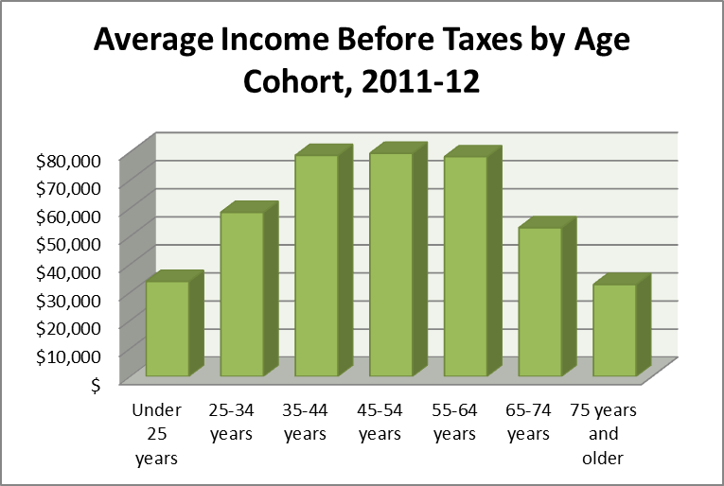
Source: Bureau of Labor Statistics Consumer Expenditure Survey (2011-12)
Notes:
This graph illustrates the potential revenue impacts; although absolute tax collections will not fall due to a growign population, per capita tax receipts will fall as the population becomes greyer.
Note: This is the age of the primary householder

Slide 45
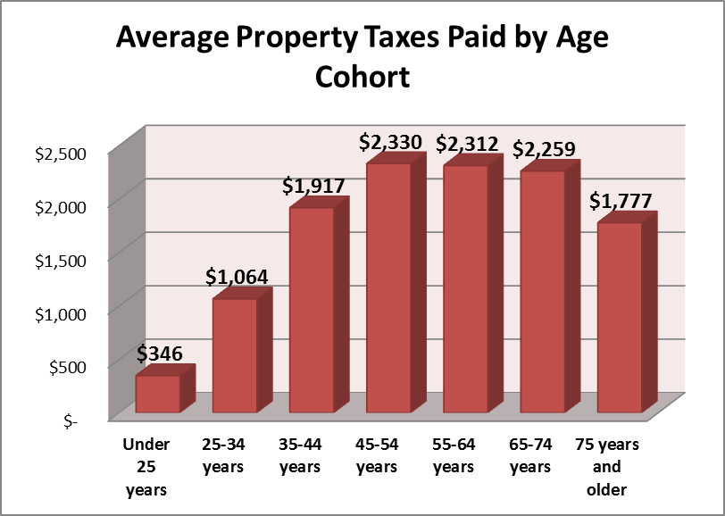
Source: Bureau of Labor Statistics Consumer Expenditure Survey (2011-12)

Slide 46
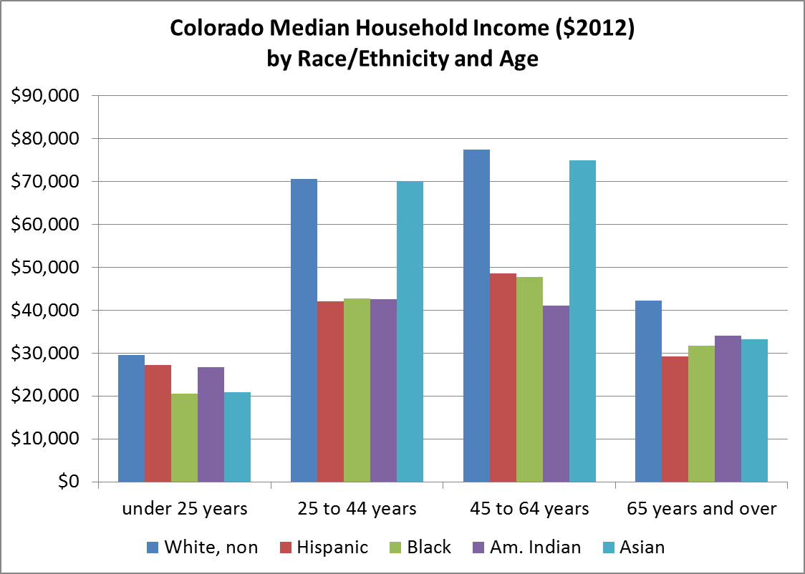
Source ACS 2012 1 yr PUMS

